Slide 1
Software Architecture
Mahesh Shirole
Microsoft Application Architecture Guide

Slide 2
Agenda
Architecture
Goals of Architecture
Principles of Architecture Design
Key Design Principles

Slide 3
Architecture
Software application architecture is the process of defining a structured solution that meets
all of the technical and operational requirements
optimizing common quality attributes such as performance, security, and manageability
It involves a series of decisions based on a wide range of factors
each of these decisions can have considerable impact on the quality, performance, maintainability, and overall success of the application

Slide 4
Architecture
Philippe Kruchten, Grady Booch, Kurt Bittner, and Rich Reitman defined as
“Software architecture encompasses the set of significant decisions about the organization of a software system including
the selection of the structural elements and their interfaces by which the system is composed;
behavior as specified in collaboration among those elements;
composition of these structural and behavioral elements into larger subsystems; and an architectural style that guides this organization.
Software architecture also involves
functionality, usability, resilience, performance, reuse, comprehensibility, economic and technology constraints, tradeoffs and aesthetic concerns.”

Slide 5
Architecture
In “Patterns of Enterprise Application Architecture”, Martin Fowler explains architecture as
“The highest-level breakdown of a system into its parts;
the decisions that are hard to change;
there are multiple architectures in a system;
what is architecturally significant can change over a system’s lifetime; and,
in the end, architecture boils down to whatever the important stuff is.”

Slide 6
Architecture
In Software Architecture in Practice (2nd edition), Bass, Clements, and Kazman define architecture as follows:
“The software architecture of a program or computing system is
the structure or structures of the system, which comprise
software elements, the externally visible properties of those elements, and the relationships among them.
Architecture is concerned with the public side of interfaces;
private details of elements—details having to do solely with internal implementation—are not architectural.”

Slide 7
Develop Library Management System
Need library system to handle: 1) issue, 2) return, and 3) loan a book to another library; hard-copy books, e-books, video-lectures, and periodicals.
What to do?
Identify key scenarios
Identify common design problems
Decide on key decisions:
How to make system more usable?
How many users will use system?
Is security required?
Do we need to explore concurrency?
How to deploy software?
Show customer system look and working before building the system

Slide 8
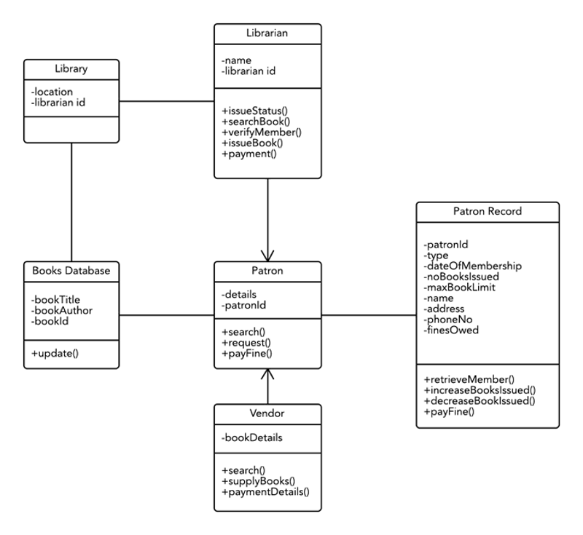
Library Management System
https://www.lucidchart.com/pages/class-diagram-for-library-management-system-UML

Slide 9
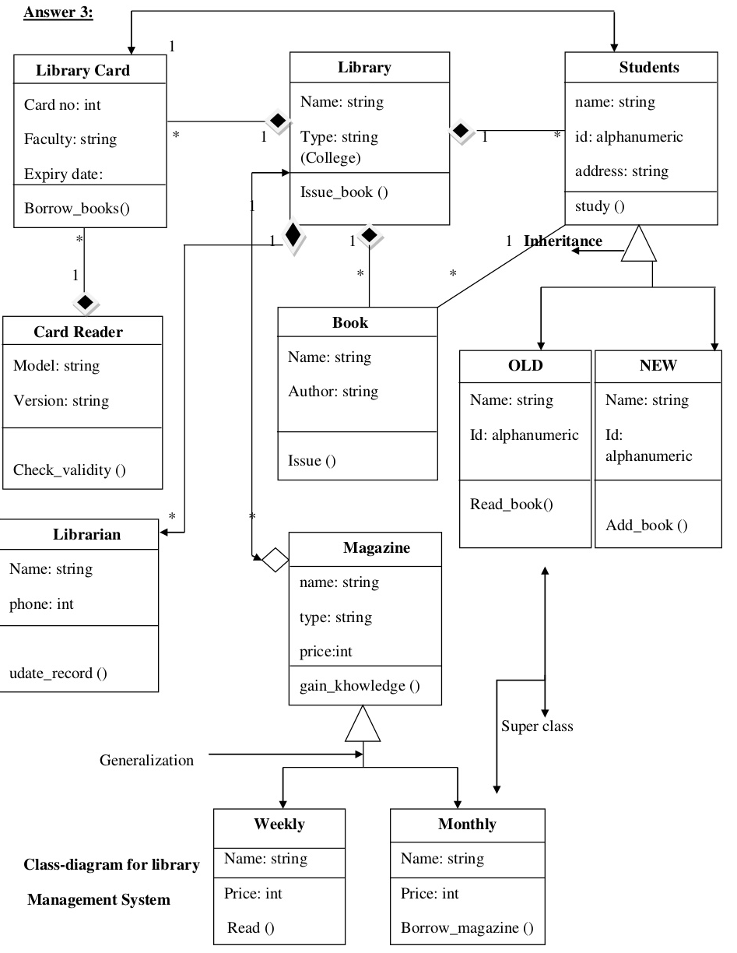
Library Management System Refined
https://www.slideshare.net/anitdgret/library-management-system-37403219

Slide 10
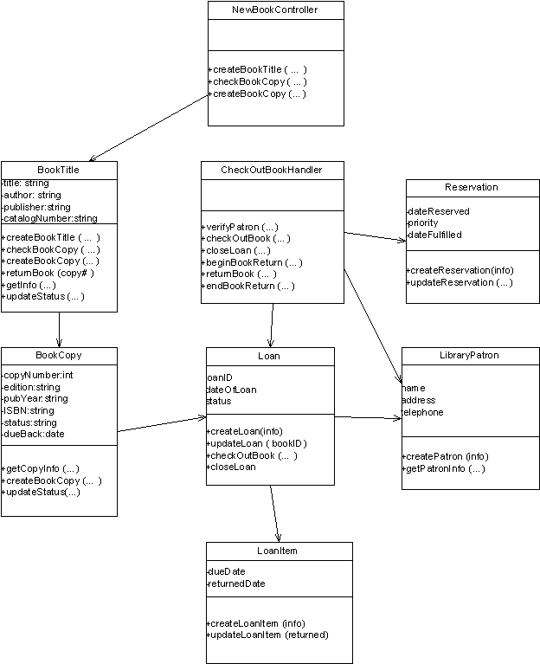
http://courses.missouristate.edu/richardjohnson/cis321/assignments/Chapter101113HomeworkCIS321.htm

Slide 11
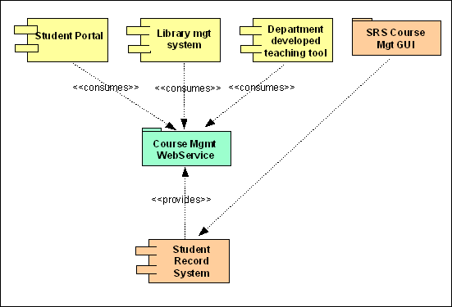
Library Management System Refined
http://homeact.me/wp-content/uploads/2017/05/absolutely-ideas-architectural-design-library-management-system-11-what-is-service-oriented-architecture.jpg

Slide 12
How is a complex architecture organized?
When we have a lot of classes (more than 20 say) we need to group them.
We would start to organize our code, diagrams, and documents into folders (or directories).
In the UML we organize artifacts into
Component
Package
Layers

Slide 13
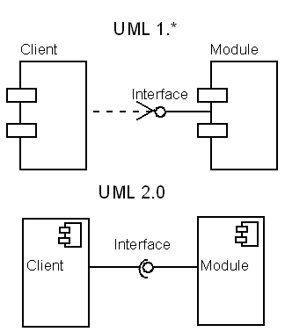
Component
Component groups classes into larger modules.
A component is plug-compatible: the user knows that it can be replaced by a similar component.

Slide 14
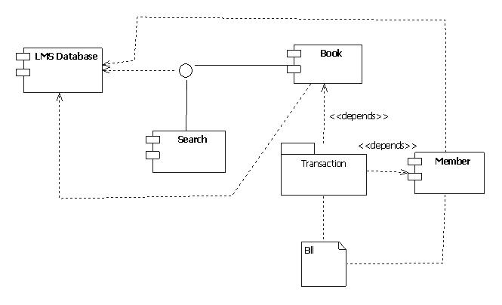
Packages
It is just like "folder“ that includes classes and components.
http://www.programsformca.com/2012/03/uml-diagrams-library-mgmt-system.html

Slide 15
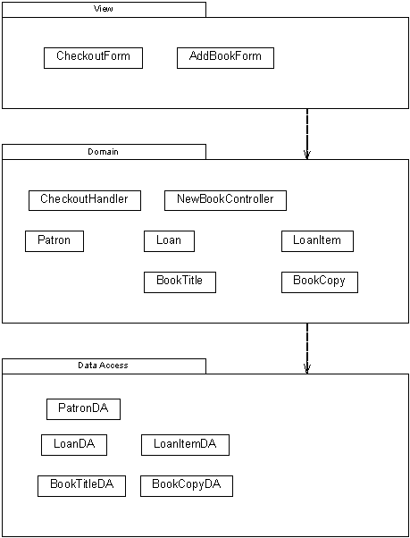
Layered Architecture of Library Management System
Layer is a group of packages, components, and classes that give complete functionality at certain level of abstraction

Slide 16
Goals of Architecture
Application architecture seeks to build a bridge between business requirements and technical requirements by understanding use cases, and then finding ways to implement those use cases in the software
The goal of architecture is to identify the requirements that affect the structure of the application
A good architecture reduces the business risks associated with building a technical solution
A good design is sufficiently flexible to be able to handle the natural drift that will occur over time in hardware and software technology, as well as in user scenarios and requirements

Slide 17
Goals of Architecture
An architect must consider the overall effect of design decisions, the inherent trade-offs between quality attributes (such as performance and security), and the tradeoffs required to address user, system, and business requirements.
The architecture should:
Expose the structure of the system but hide the implementation details.
Realize all of the use cases and scenarios.
Try to address the requirements of various stakeholders.
Handle both functional and quality requirements.

Slide 18
Architectural Key Forces
Key forces shaping architectural decisions are user empowerment, market maturity, flexible design, and future trends
These key forces are allow faster results, better support for varying work styles and workflows, and improved adaptability of software design
User empowerment
A design that supports user empowerment is flexible, configurable, and focused on the user experience
Design your application with appropriate levels of user personalization and options in mind

Slide 19
Architectural Key Forces
Market Maturity
Take advantage of market maturity by taking advantage of existing platform and technology options
Build on higher level application frameworks
Use patterns that provide rich sources of proven solutions for common problems
Flexible Design
Increasingly, flexible designs take advantage of loose coupling to allow reuse and to improve maintainability
Pluggable designs allow you to provide post-deployment extensibility
Take advantage of service orientation techniques such as SOA to provide interoperability with other systems
Future Trends
Understand the future trends that might affect your design after deployment
consider trends in rich UI and media, increasing network bandwidth and availability, increasing use of mobile devices, continued improvement in hardware performance, the rise of cloud-based computing, and remote operation

Slide 20
Principles of Architecture Design
Current thinking on architecture assumes that your design will evolve over time
Consider the following key principles when designing your architecture:
Build to change instead of building to last
Model to analyze and reduce risk
Use models and visualizations as a communication and collaboration tool
Identify key engineering decisions

Slide 21
Architectural Design
Consider using an incremental and iterative approach to refining your architecture
Start with a baseline architecture
Do not try to get it all right the first time
design just as much as you can in order to start testing the design against requirements and assumptions
Iteratively add details to the design over multiple passes to make sure that you get the big decisions right first, and then focus on the details

